Slide 1
We need to talk about Gameplays
Presented by Marcel Bravo, reseacher in Applied Gameplay Science
Notes:
Seed: Gameplay Generator: Title slide Context: {'topic': 'Gameplay', 'presenter': 'Marcel Bravo', 'seed': 'Gameplay', 'seed_plural_title': 'Gameplays', 'seed_title': 'Gameplay'} Generated Elements: ['We need to talk about Gameplays', 'Presented by Marcel Bravo, reseacher in Applied Gameplay Science']

Slide 2
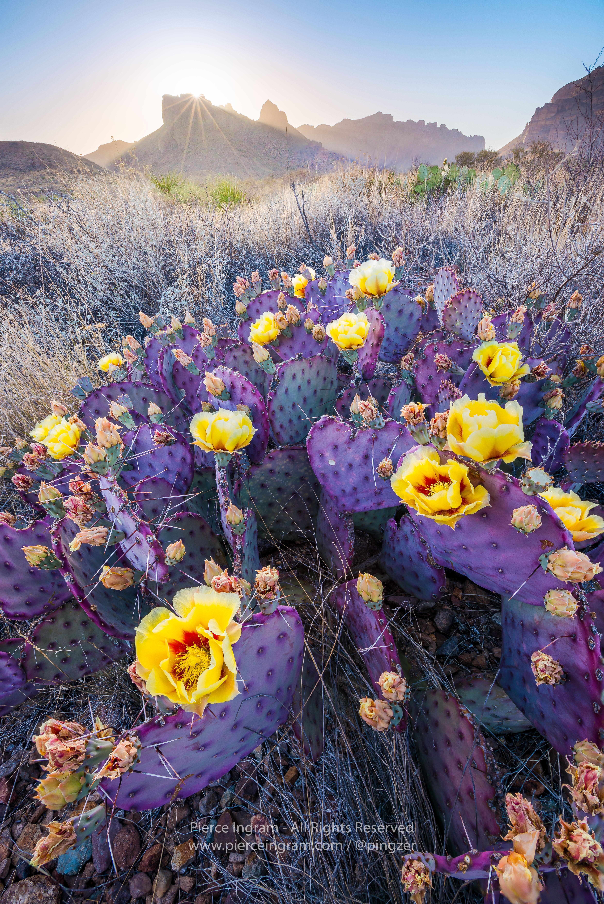
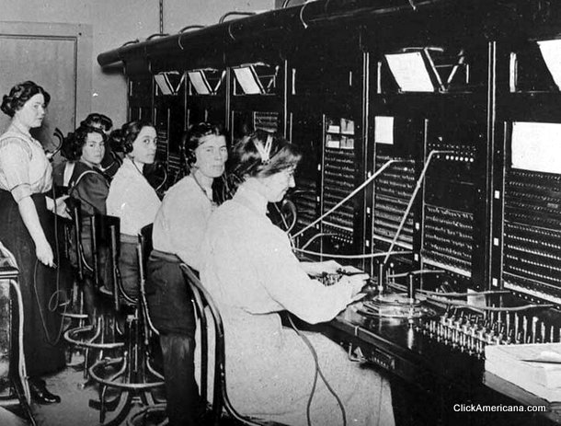

Some things about me
Where I get my inspiration
Telephone Operator
Obsession
Notes:
Seed: Gameplay Generator: About Me: Location-Job-WeirdHobby Context: {'topic': 'Gameplay', 'presenter': 'Marcel Bravo', 'seed': 'Gameplay'} Generated Elements: ('Some things about me', 'Where I get my inspiration', '/app/talkgenerator/schema/../../downloads/reddit/evilbuildings+itookapicture+SkyPorn+EarthPorn/z2iyu7ozmgn21.jpg', 'Telephone Operator', '/downloads/google_images/Telephone Operator/__(1).jpg', 'Obsession', '/app/talkgenerator/schema/../../downloads/shitpostbot/ronaldo-57fac638159f2.jpeg', True)

Slide 3
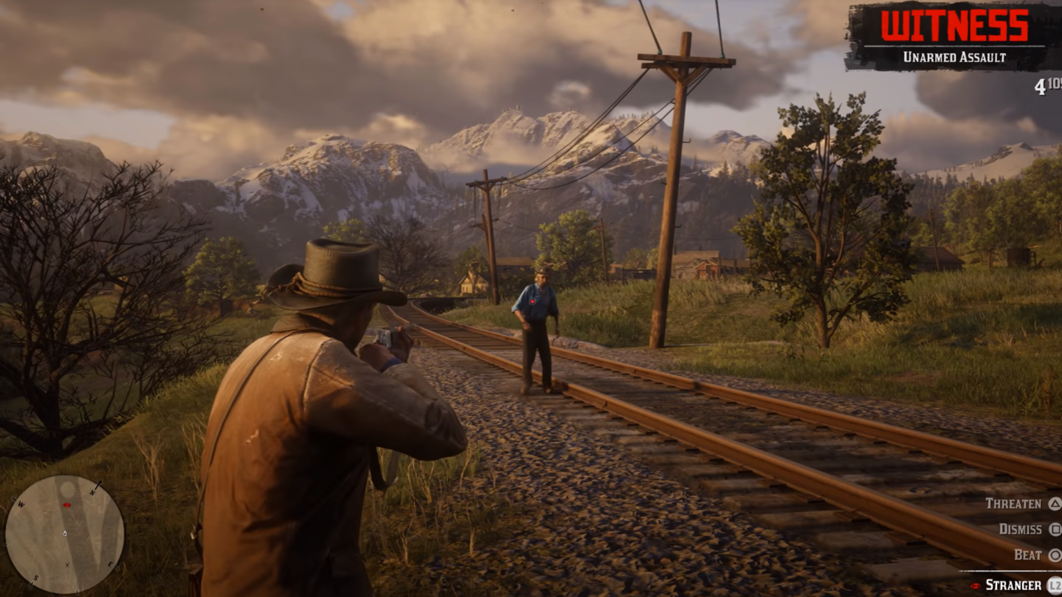
Notes:
Seed: Gameplay Generator: Full Screen Google Images Context: {'topic': 'Gameplay', 'presenter': 'Marcel Bravo', 'seed': 'Gameplay'} Generated Elements: [None, '/downloads/google_images/Gameplay/rxwhmhrxguqcgahnhvzo.png', True]

Slide 4
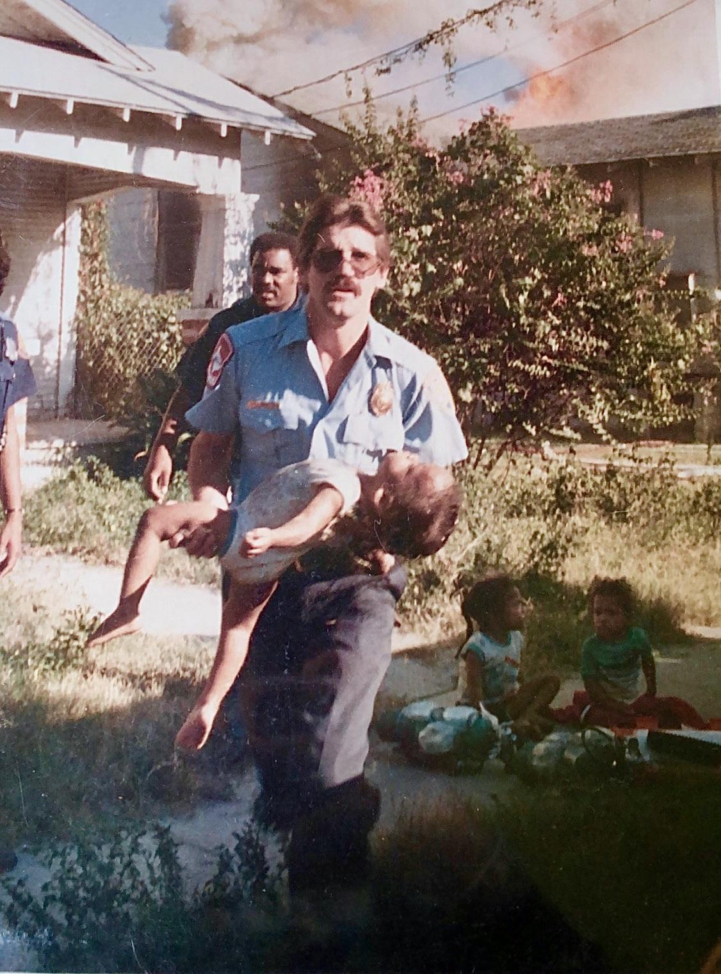
Important Figures in Gameplay History
"The Elder Scrolls Online Gameplay 1080p [54445] Follow the instructions: Step 1) Search Google.com For "special keygens and hacks" Step 2) Click the 1st or 2nd place result which is a Facebook Page or Pagebin Enjoy! :)"
Governor Ismael Zick
Notes:
Seed: Gameplay Generator: Historical Figure Quote Context: {'topic': 'Gameplay', 'presenter': 'Marcel Bravo', 'seed': 'Gameplay', 'seed_title': 'Gameplay'} Generated Elements: ['Important Figures in Gameplay History', 'Governor Ismael Zick', '/app/talkgenerator/schema/../../downloads/reddit/OldSchoolCool/9ahootvkcgr21.jpg', None, '"The Elder Scrolls Online Gameplay 1080p [54445] \n\nFollow the instructions:\n\nStep 1) Search Google.com For "special keygens and hacks"\n\nStep 2) Click the 1st or 2nd place result which is a Facebook Page or Pagebin\n\nEnjoy! :)"', True]

Slide 5
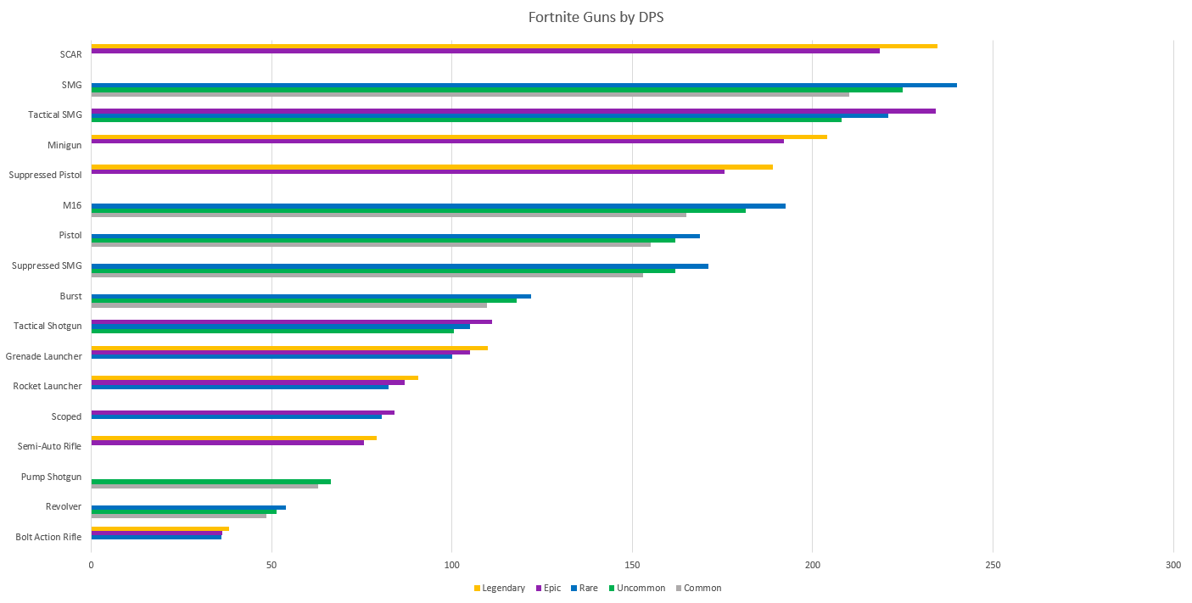
Notes:
Seed: Gameplay Generator: Reddit Chart Context: {'topic': 'Gameplay', 'presenter': 'Marcel Bravo', 'seed': 'Gameplay'} Generated Elements: [None, '/app/talkgenerator/schema/../../downloads/reddit/dataisbeautiful+funnycharts+charts/g4ybr4bme9i01.png', True]

Slide 6
About Gameplays
Notes:
Seed: Gameplay Generator: Single Image Giphy Context: {'topic': 'Gameplay', 'presenter': 'Marcel Bravo', 'seed': 'Gameplay', 'seed_is_noun_plural_title': 'Gameplays'} Generated Elements: ['About Gameplays', '/app/talkgenerator/schema/../../downloads/reddit/gifs+gif+gifextra+nonononoYES/lFlJjYs.gif', True]

Slide 7
Are you afraid of category:ing gaming youtube channels 379 views updated 2 weeks ago?
Notes:
Seed: Gameplay Generator: Yes/No/Funny Chart Context: {'topic': 'Gameplay', 'presenter': 'Marcel Bravo', 'seed': 'Gameplay', 'seed_wikihow_action_ing_lower': 'category:ing gaming youtube channels\n\n\n\n\n\t\t\t\t\t\t379 views\t\t\t\t\t\n\xa0\n\n\n\t\t\t\t\t\tupdated 2 weeks ago', 'chart_title': 'Are you afraid of category:ing gaming youtube channels\n\n\n\n\n\t\t\t\t\t\t379 views\t\t\t\t\t\n\xa0\n\n\n\t\t\t\t\t\tupdated 2 weeks ago?'} Generated Elements: ('Are you afraid of category:ing gaming youtube channels\n\n\n\n\n\t\t\t\t\t\t379 views\t\t\t\t\t\n\xa0\n\n\n\t\t\t\t\t\tupdated 2 weeks ago?', 51, <pptx.chart.data.ChartData object at 0x7fa2e888bb70>, <function set_histogram_properties at 0x7fa2e9a49840>)

Slide 8
Gameplays
Present
Future
Notes:
Seed: Gameplay Generator: Two Captions Gifs Context: {'topic': 'Gameplay', 'presenter': 'Marcel Bravo', 'seed': 'Gameplay', 'seed_plural_title': 'Gameplays'} Generated Elements: ('Gameplays', 'Present', '/app/talkgenerator/sources/../downloads/giphy/Gameplay/uhXoE6N6xgHy8.gif', 'Future', '/app/talkgenerator/sources/../downloads/giphy/Gameplay/EXdlDHfwoaYj6.gif', True)

Slide 9
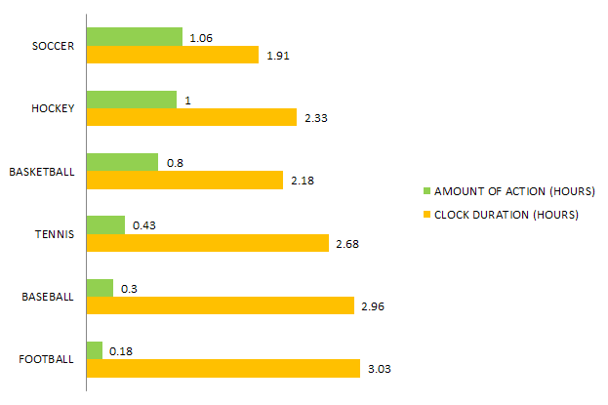
Notes:
Seed: Gameplay Generator: Reddit Chart Context: {'topic': 'Gameplay', 'presenter': 'Marcel Bravo', 'seed': 'Gameplay'} Generated Elements: [None, '/app/talkgenerator/schema/../../downloads/reddit/dataisbeautiful+funnycharts+charts/y0wErLS.png', True]

Slide 10
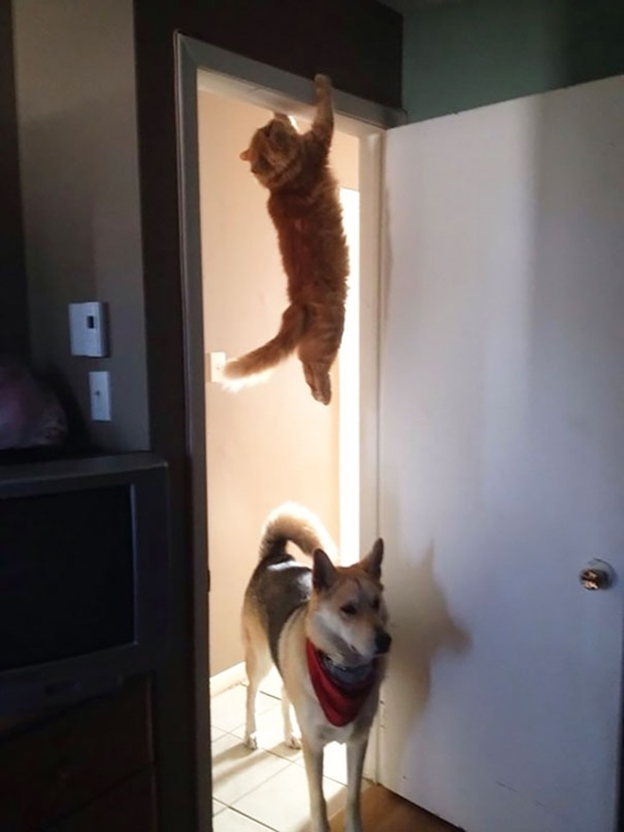
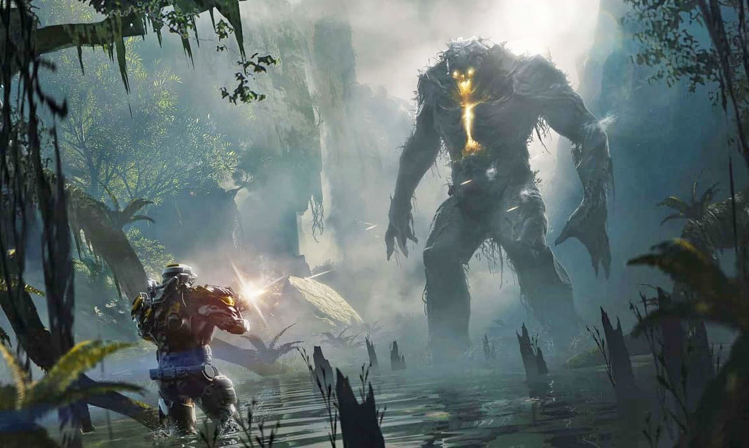
Ending Points
Conclusion 1
Conclusion 2
Conclusion 3
Notes:
Seed: Gameplay Generator: Conclusion Context: {'topic': 'Gameplay', 'presenter': 'Marcel Bravo', 'seed': 'Gameplay'} Generated Elements: ['Ending Points', 'Conclusion 1', '/downloads/google_images/Gameplay/dims?quality=85&image_uri=http%3a%2f%2fo.aolcdn.com%2fhss%2fstorage%2fmidas%2fc43d889473862b1a71f9c872ff67bdfa%2f206506851%2fanthem-ed.jpg&client=amp-blogside-v2&signature=9776753f01777441e00b9acabd734dd34ea2f6b5.jpg', 'Conclusion 2', '/app/talkgenerator/schema/../../downloads/reddit/hmmm+hmm+wtf+wtfstockphotos+photoshopbattles+confusing_perspective+cursedimages+HybridAnimals+EyeBleach+natureismetal/jwjs8oeh32o21.png', 'Conclusion 3', '/app/talkgenerator/schema/../../downloads/reddit/gifs+gif+gifextra+nonononoYES/yEkJsKB.gif', True]

